Slide 1
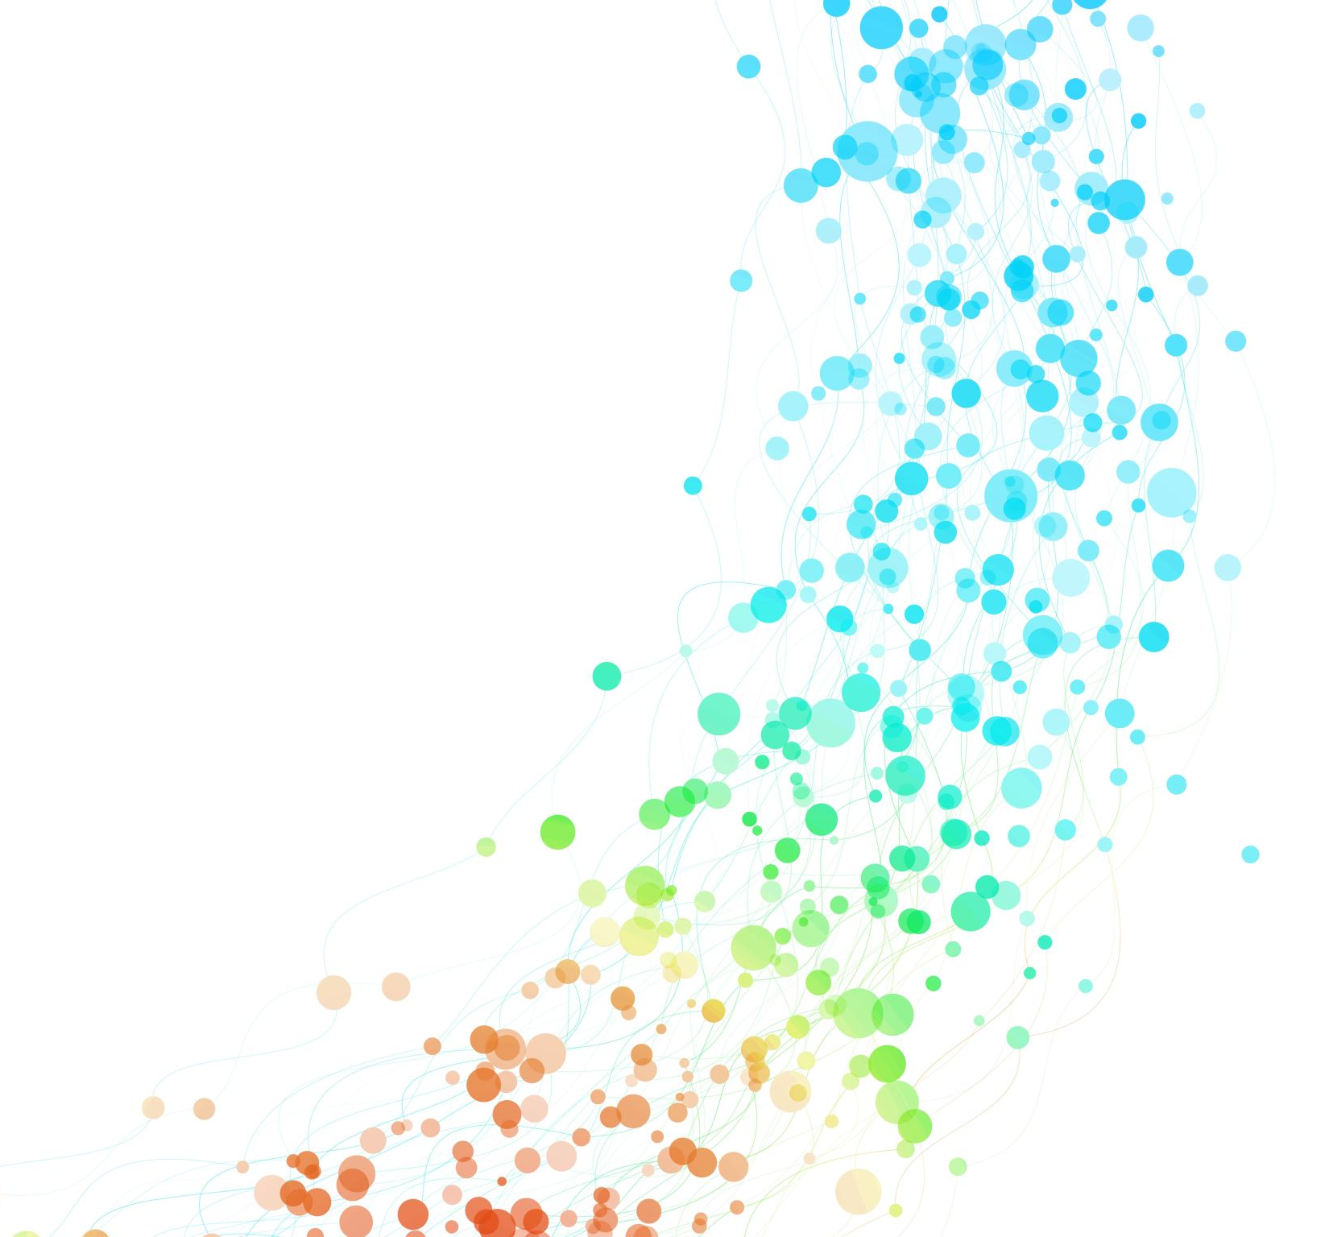
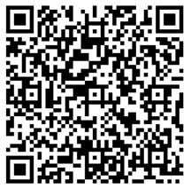

Join us – be the voice that shapes policing
What you would do as a member of the IAG:
Challenge and influence police thinking
Provide independent, honest advice to Wolverhampton Police
Bring real community concerns/insights to the table
Help improve, trust, confidence and communication
Highlight the issues that matter locally
The ask would be around 6 meetings per year
To note this is a voluntary, unpaid position
Join the Wolverhampton Independent Advisory Group (IAG) and influence how policing works in your community
Interested?
Apply now and make a difference.
Scan this QR code to register your interest or click on the link below
Register an interest in joining the Wolverhampton IAG – Fill in form
Your Voice Matters. Your Experience Matters. Your Community Matters.

